Slide 1
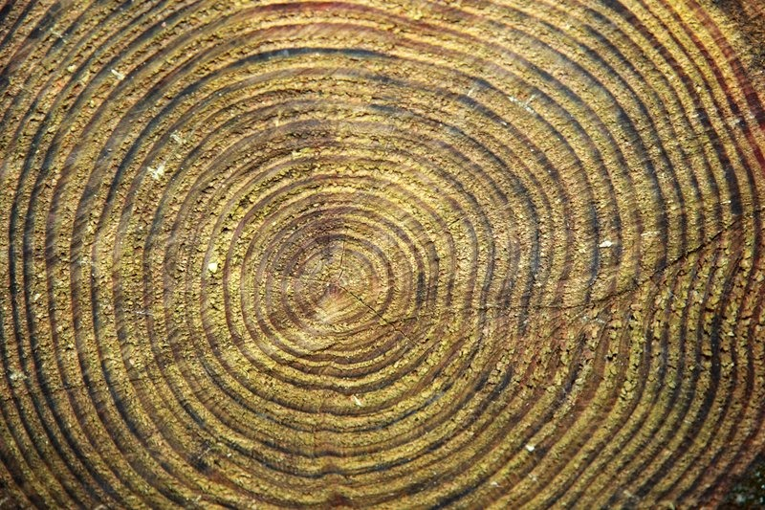
Support in plants

Slide 2
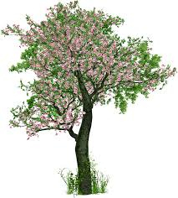
Support in plants
Terrestrial plants need to stand upright and extend their branches so that they can:
get maximum sunlight for photosynthesis
lift their flowers up for a better chance of pollination
helps dispersal of fruits and seeds over a wide area
Support in plants is mainly provided by the turgidity of thin-walled cells and the rigidity of thick-walled cells.

Slide 3
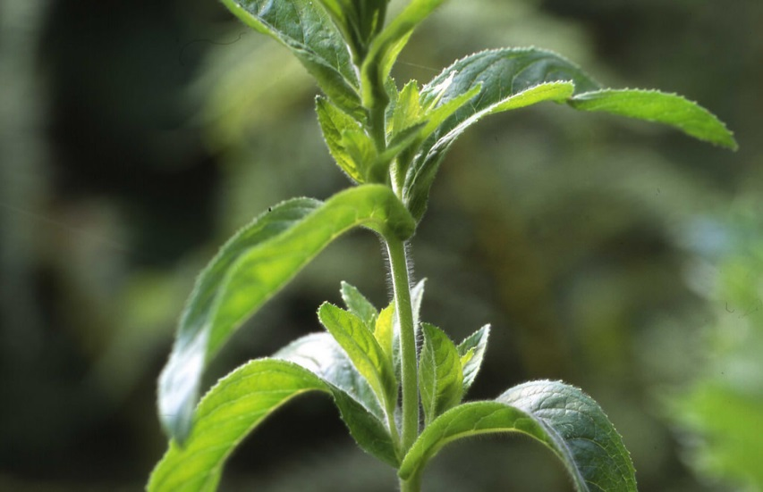
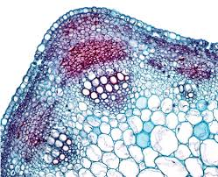
Turgidity of thin-walled cells
In herbaceous plants, the cortex and pith of the stems consist of thin-walled cells which are closely packed.
When water supply is adequate, the thin-walled cells gain water by osmosis.
cells become turgid and press against each other
The turgidity of these cells supports the stem to stand upright.

Slide 4
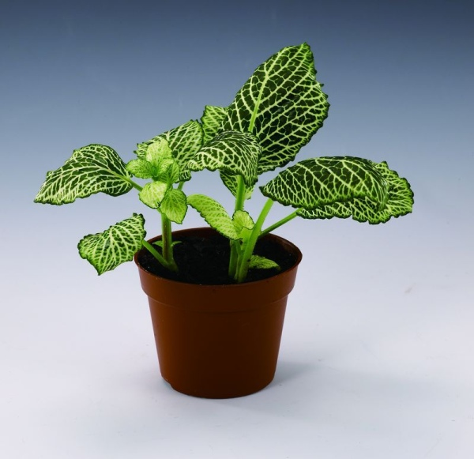
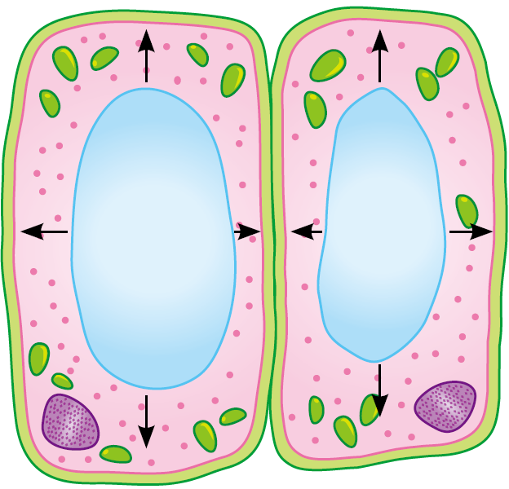
Turgidity of thin-walled cells
the main way of herbaceous plants or non-woody plant parts to gain support
Turgid cells press against each
other to give support to the plant.
When water supply is adequate, the plant gains support from the turgidity of the thin-walled cells.

Slide 5
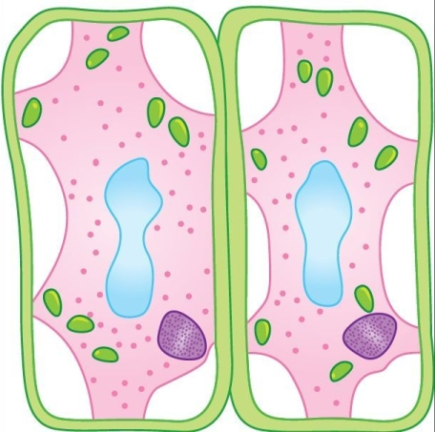
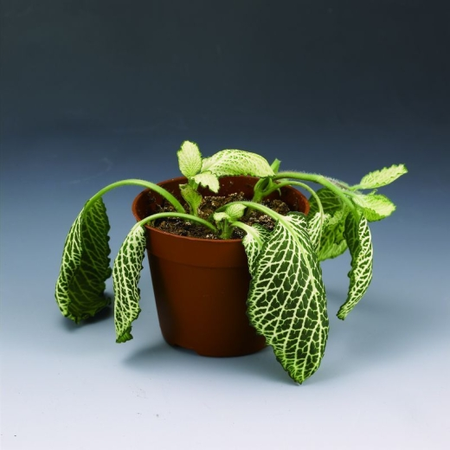
Turgidity of thin-walled cells
wilting: a condition that the stems become soft and limp as they are no longer supported by cell turgidity
When water supply is inadequate, the thin-walled cells in the cortex and pith become flaccid and the plant wilts.

Slide 6
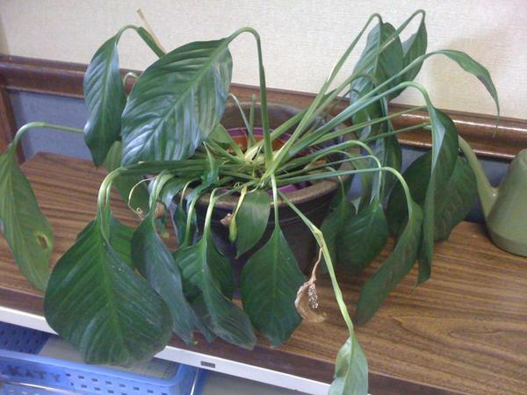
Turgidity of thin-walled cells
Temporary wilting may occur on hot dry days when transpiration takes place faster than water uptake.
If water is given back to the wilted plant, the cells will become turgid and the plant will stand upright again.

Slide 7
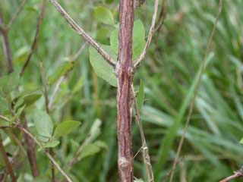
Rigidity of thick-walled cells
In woody plants, the stems are mainly supported by the rigidity of thick-walled cells, such as xylem vessels.
The cell walls of xylem vessels contain lignin, which makes them hard and rigid.
more xylem tissue is formed as the woody plant grows older

Slide 8
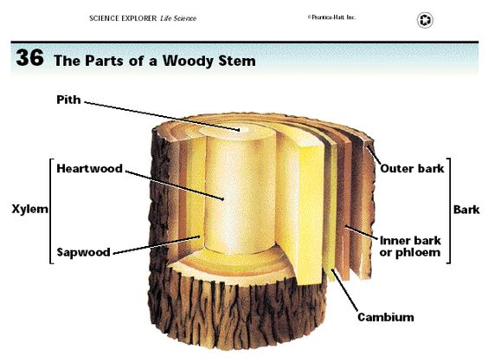
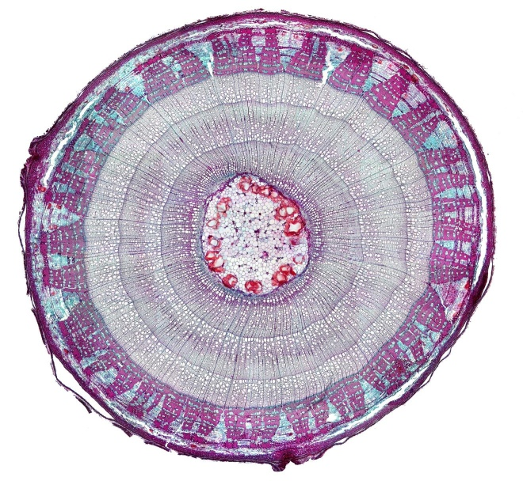
Rigidity of thick-walled cells
the older xylem tissues in the stem are pushed inwards by the newly formed tissues
become hard wood tissues which contribute to the strength of the woody stems
bark
phloem
The xylem makes up a large part of a woody stem.
xylem
T.S.x20

Slide 9

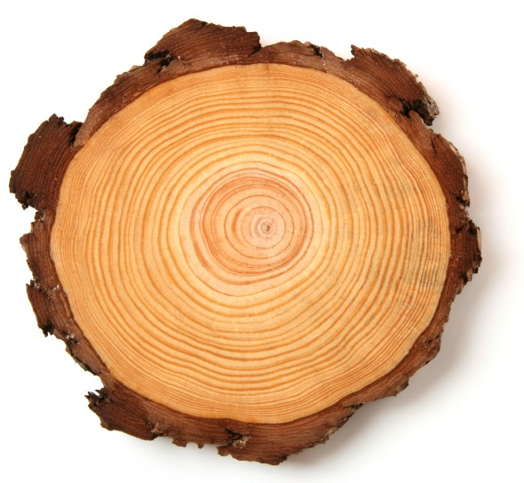
Extras— Do you know?
Annual rings
Annual rings can be seen in the cross-section of a woody stem.
Each annual ring consists of a light layer and a dark layer.
This results from the change in growth rate in different seasons of the year.
Cross-section of a tree trunk

Slide 10
Extras— Do you know?
Annual rings
The xylem formed in the spring has a relatively large lumen and thin walls. They form the springwood which appears lighter in colour.
The xylem formed in the summer and autumn has a smaller lumen and thicker walls. They form the summerwood which appears darker than the springwood.

Slide 11
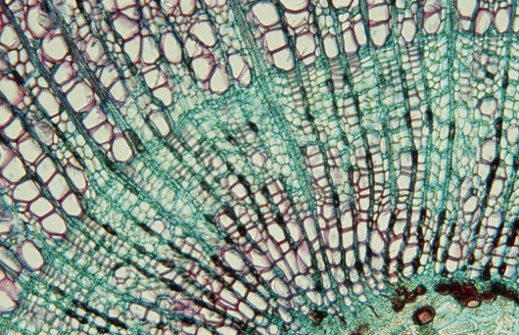
Extras— Do you know?
Annual rings
As one annual ring corresponds to one year of growth, the age of a woody plant can be estimated by counting the annual rings in the tree trunk.
summerwood
Photomicrograph of a woody stem showing springwood (pink) and summer wood (green) (x80)
springwood

Slide 12
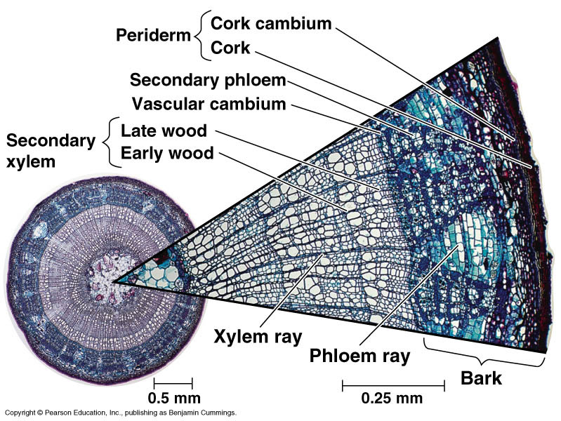
Figure 35.22 Anatomy of a three-year-old stem

Slide 13

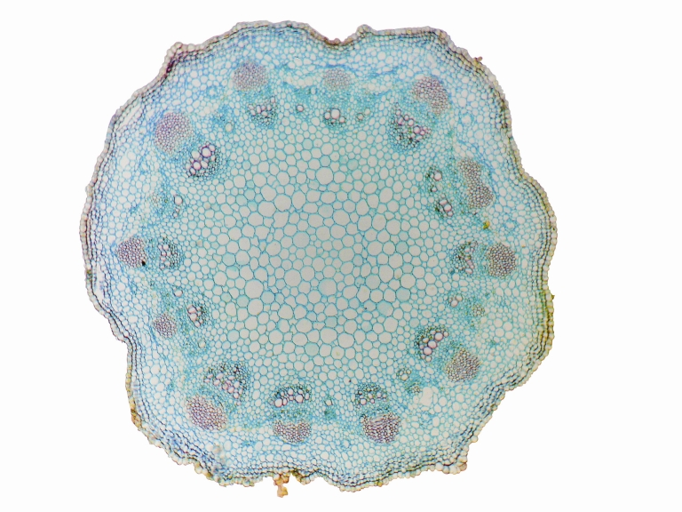
Quick Practice
The photomicrograph below shows the cross section through the stem of a dicotyledonous plant.
Y
Z
X

Slide 14
Quick Practice
Which types of tissues can provide support to plant?
X and Y only
X and Z only
Y and Z only
X, Y and Z
A

Slide 15
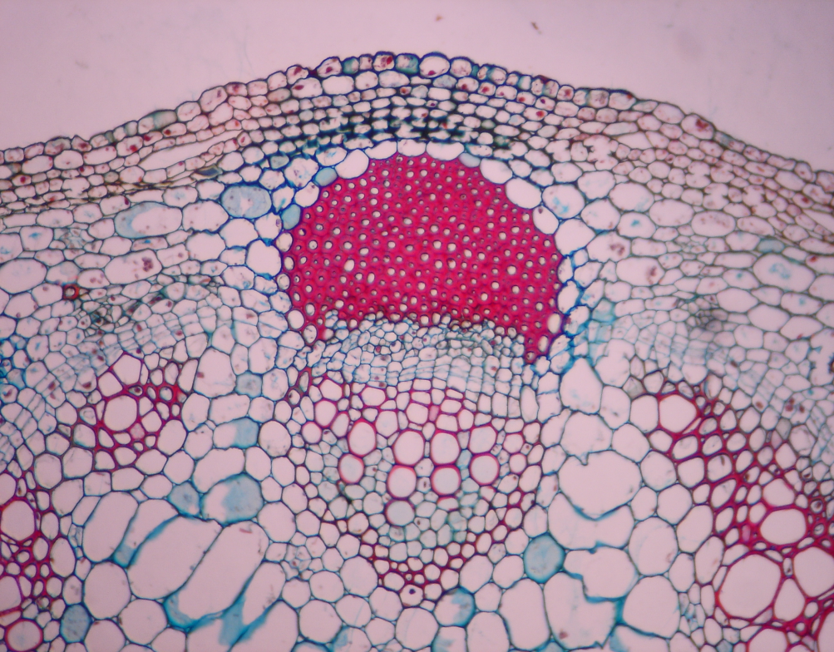
How are the cell types of the dicot stem adapted to support?
Living cells with thick cell wall to provide mechanical strength.
Thick-wall cell
(Collenchyma):
Cells with thick, lignified cell wall to provide mechanical strength.
Fibres
Xylem
Thin-walled cells with large vacuoles – make the stem hard and rigid when turgid.
Parenchyma in cortex and pith

